Slide 1
Improving Access to Physical Therapies
Prof Andrew Walton
Founder, Group Executive Director, Visiting Professor Leeds Beckett University, Chair MSKPN
Connect Health
andrewwalton@connecthealth.co.uk
#EHMA2020

Slide 2
Who are we?
Connect Health is a leading community services healthcare provider encompassing mental health, psychological interventions, MSK (musculoskeletal) conditions, pain, orthopaedics, rheumatology and occupational health services, serving over 350k NHS patients pa across 28 NHS CCGs/Trusts and 100+ organisational services. Services cover more than 10% of England’s population.
Identified by the Financial Times as one of the top 20 consultancies operating in the public sector, GGI brings a decade of experience working with leaders on the broad canvas of governance.
#EHMA2020

Slide 3
What is IAPT - Context
Today, almost one in four people in the UK have a mental health condition.
The Improving Access to Psychological Therapies (IAPT) programme was introduced in 2008 to improve the treatment of common mental health conditions by primary care organisations in England.
In 2018/19, 1.6 million people were referred to IAPT services and 1.09 million entered treatment. 67% of those who experience a course of treatment show reliable and substantial reductions in their anxiety and/or depression; and 51% of these improve to the point at which they are classified as recovered
Reflecting this success, the NHS Long Term Plan (LTP) proposed the further expansion of IAPT services, with a target of 1.9 million people to be seen by 2024. It also sets out sensible proposals for integrated IAPT services which have since begun to be acted upon.
#EHMA2020

Slide 4
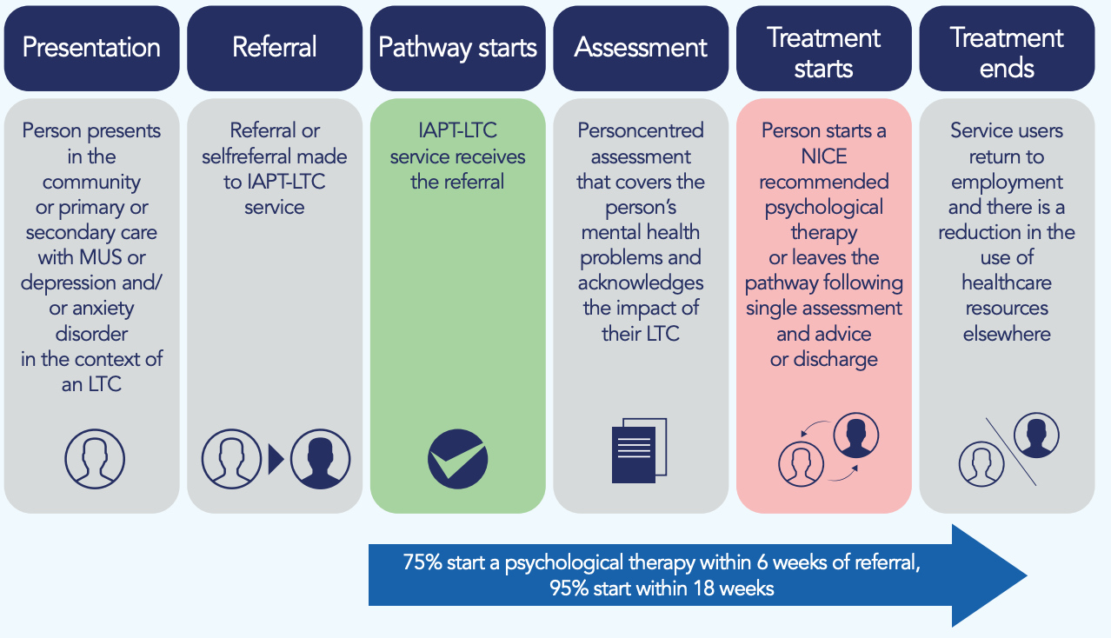
What are IAPT services?
#EHMA2020

Slide 5
Key challenges to delivering IAPT services
Connect Health has built a unique level of specialist expertise in delivering sustained transformation through its sophisticated infrastructure, digital tools, highly advanced clinical and operational insight and change methodology.
#EHMA2020

Slide 6
Our guidance
Targeted at NHS commissioners and providers of IAPT services
Explored the practical realities of the implementation of IAPT through the prism of governance
A high-level governance tool that can support Boards to better understand the IAPT programme and to also take better decisions with regards to its implementation.
What we did - Desk-based research, Scoping interviews with senior staff from across a range of organisations with practical experience of the IAPT programme, Focus groups to test content of the guidance
#EHMA2020

Slide 7
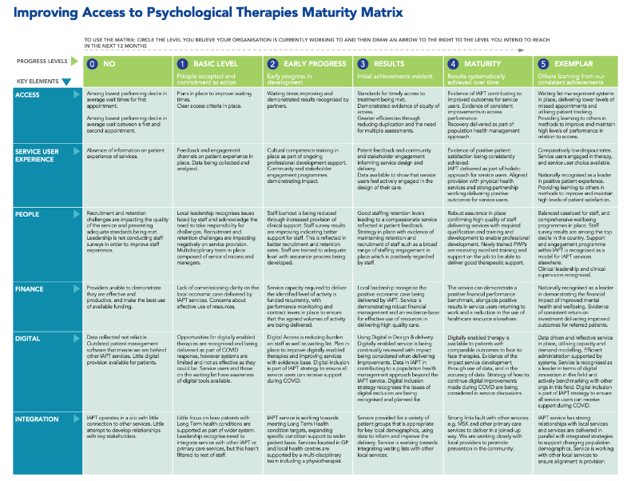
What is the tool?
The programme of work has resulted in the production of a tool (Board Assurance Prompt) that contains the following:
A briefing on the current context of IAPT services in England
A series of key assurance questions Board members will want to ask themselves when designing or procuring IAPT services
A maturity matrix to support NHS organisations assess the maturity and effectiveness of their IAPT services, and make appropriate improvements
#EHMA2020

Slide 8
Six key principles
Ease of access
Least intrusive intervention first
Trained and competent clinicians
Meaningful choice
Routine, outcome monitoring
Close links
Including the use of self-referrals
In line with NICE-recommended psychological therapies and a stepped-care model
Who have regular clinical supervision that is outcome-focused and supportive
In treatment
Session by session
With primary care, specialist mental health services, third sector, social care and employment support services.
#EHMA2020

Slide 9
Outcomes and opportunities
IAPT is one of the main NHS services to support the mental health of the public
Crucial interface between physical and mental health to deliver improved outcomes for communities
Further highlighted within COVID-19 recovery efforts and long term needs
Employment and psychosocial support are key priorities for physical and mental health integration with wide ranging benefits for society
Recruitment and retention - multidisciplinary teams and staff satisfaction
#EHMA2020

Slide 10
More information
Find out more about Connect Health here
https://www.connecthealth.co.uk/mental-health/
Find out more about the Good Governance Institute here
http://good-governance.org.uk/
#EHMA2020

