Slide 1
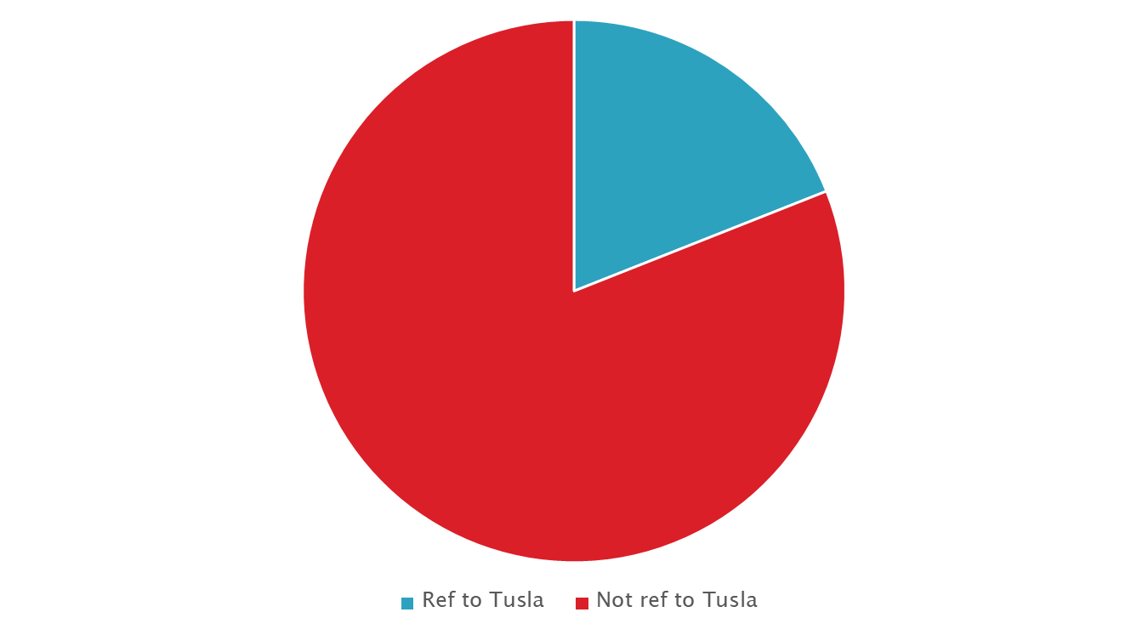
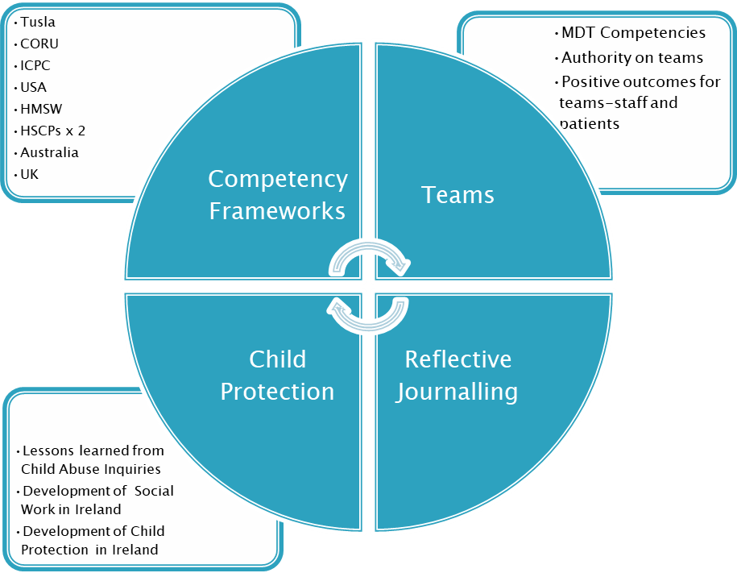
Examining specific leadership competencies of Medical Social Workers used in managing Child Protection Cases within Multi-disciplinary Teams in a Children’s Hospital
Sheila Mc Crory, Head Medical Social Worker, Children’s Health Ireland at Crumlin, Dublin.
Background and Introduction
Part of Masters in Leadership in Healthcare IMI/Leadership Academy HSE/UCC
HMSW in largest children’s hospital in Ireland
21 medical social workers attached to multi-disciplinary teams
Child Protection is a priority area in department.
The hospital refers on Child Protection cases to Tusla Child and Family Agency
Co-incidence-2019=when research being written up was 100th anniversary of the almoner-early MSW
Children First Act 2015-came into effect in December 2017 along with Children First Guidance
Introduction of Mandatory Reporting by a variety of healthcare professionals to Tusla over a defined threshold of harm
Joint reporting with MSWs providing support to other professionals
2018 stats in MSW Department indicated 2843 referrals received
Of these 655 were of a child protection/welfare nature-see pie chart
Of these 124 were referred to Tusla-see pie chart
Of these 86 were mandated reports
Of these 51 were joint reports sent between MSW and a professional with a concern.
Methods
“How will doctors and nurses know what competencies MSW use?”
Because they see them! Competencies which are visible to MDT
30 competencies narrowed down to 5 MDT ones:
Communication
Information-sharing
Collaborative working
Interagency working
multidisciplinary working
Qualitative approach, Semi-structured interviews
12 interviews with consultants and senior nurses
Focused on:
Emergency Department, General Paediatrics, followed by Neonatology, Burns and Psychiatry as highest referrers to MSW and on under 1 and over 10 age group as these groups had higher proportions of cases.
Researcher also explored areas with/and without MSW assigned.
Researcher also explored areas with/ and without regular multi-disciplinary meetings.
Some staff had completed joint reports with Medical Social Work to Tusla.
Results
Experienced changes under Children First | Didn’t experience changes under Children First
4 nurses | 4 doctors
2 doctors | 2 nurses
Total 6/12 | Total 6/12
Emotional Impact “fear a child could not end up going into care. I lost sleep over it”
MSW Access and Knowledge “We’re dependent to be given a steer on things”
Challenging professionals “I’m not sure every consultant would be making the right call (about a child Protection case)…I’ve never heard of a case where social worker has taken the lead and said I’m not happy actually”
Tusla and how MSW helps-interviewees spoke of benefit of a medical social worker who had previously worked in Tusla
Leadership and interpersonal competencies “How do they show leadership? By acting. By doing what they do. I’m thinking of old footballers and best captains, they just play ball”
Conclusion
.
Consultants and senior nurses value MSW department as source of knowledge and guidance re Child Protection cases
Interviewees acknowledge huge emotional impact of work
Positive feedback re social workers use of: effective communication, information sharing, collaboration and multi-disciplinary and interagency working
Having a MSW assigned is a good thing, as is having a regular MDT
Incidental findings re Tusla and MSW mitigation-perceived power of Tusla, Tusla seen as working against the hospital, MSW role in advocacy with Tusla.

